Slide 1
Docker PDT
Juan Arellano
10/30/2020

Slide 2
Agenda
Introduce Docker
Why is Docker great?
Code Examples
Resources
Questions

Slide 3

Goal of today’s presentation

Slide 4
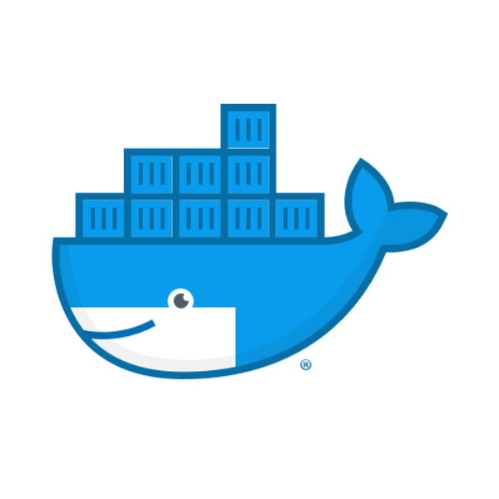
Goal of today’s presentation

Slide 5
What is Docker?

Slide 6
What is Docker?
Docker is a tool designed to make it easier to create, deploy, and run applications by using containers. Containers allow a developer to package up an application with all of the parts it needs, such as libraries and other dependencies, and deploy it as one package.
Notes:
In a way, Docker is a bit like a virtual machine. But unlike a virtual machine, rather than creating a whole virtual operating system, Docker allows applications to use the same Linux kernel as the system that they're running on and only requires applications be shipped with things not already running on the host computer. This gives a significant performance boost and reduces the size of the application.

Slide 7
What is Docker? - Terminology
Dockerfile: A text file that contains instructions for building a Docker image. It's like a batch script, the first line states the base image to begin with and then follow the instructions to install required programs, copy files, and so on, until you get the working environment you need.
Notes:
In a way, Docker is a bit like a virtual machine. But unlike a virtual machine, rather than creating a whole virtual operating system, Docker allows applications to use the same Linux kernel as the system that they're running on and only requires applications be shipped with things not already running on the host computer. This gives a significant performance boost and reduces the size of the application.

Slide 8
What is Docker? - Terminology
Dockerfile: A text file that contains instructions for building a Docker image. It's like a batch script, the first line states the base image to begin with and then follow the instructions to install required programs, copy files, and so on, until you get the working environment you need.
Container image: A package with all the dependencies and information needed to create a container. An image includes all the dependencies (such as frameworks) plus deployment and execution configuration to be used by a container runtime. Usually, an image derives from multiple base images that are layers stacked on top of each other to form the container's filesystem. An image is immutable once it has been created.
Notes:
In a way, Docker is a bit like a virtual machine. But unlike a virtual machine, rather than creating a whole virtual operating system, Docker allows applications to use the same Linux kernel as the system that they're running on and only requires applications be shipped with things not already running on the host computer. This gives a significant performance boost and reduces the size of the application.

Slide 9
What is Docker? - Terminology
Dockerfile: A text file that contains instructions for building a Docker image. It's like a batch script, the first line states the base image to begin with and then follow the instructions to install required programs, copy files, and so on, until you get the working environment you need.
Container image: A package with all the dependencies and information needed to create a container. An image includes all the dependencies (such as frameworks) plus deployment and execution configuration to be used by a container runtime. Usually, an image derives from multiple base images that are layers stacked on top of each other to form the container's filesystem. An image is immutable once it has been created.
Container: An instance of a Docker image. A container represents the execution of a single application, process, or service. It consists of the contents of a Docker image, an execution environment, and a standard set of instructions. When scaling a service, you create multiple instances of a container from the same image. Or a batch job can create multiple containers from the same image, passing different parameters to each instance.
Notes:
In a way, Docker is a bit like a virtual machine. But unlike a virtual machine, rather than creating a whole virtual operating system, Docker allows applications to use the same Linux kernel as the system that they're running on and only requires applications be shipped with things not already running on the host computer. This gives a significant performance boost and reduces the size of the application.

Slide 10
What is Docker? - Terminology
Dockerfile: A text file that contains instructions for building a Docker image. It's like a batch script, the first line states the base image to begin with and then follow the instructions to install required programs, copy files, and so on, until you get the working environment you need.
Container image: A package with all the dependencies and information needed to create a container. An image includes all the dependencies (such as frameworks) plus deployment and execution configuration to be used by a container runtime. Usually, an image derives from multiple base images that are layers stacked on top of each other to form the container's filesystem. An image is immutable once it has been created.
Container: An instance of a Docker image. A container represents the execution of a single application, process, or service. It consists of the contents of a Docker image, an execution environment, and a standard set of instructions. When scaling a service, you create multiple instances of a container from the same image. Or a batch job can create multiple containers from the same image, passing different parameters to each instance.
Compose: A command-line tool and YAML file format with metadata for defining and running multi-container applications. You define a single application based on multiple images with one or more .yml files that can override values depending on the environment. After you've created the definitions, you can deploy the whole multi-container application with a single command (docker-compose up) that creates a container per image on the Docker host.
Notes:
In a way, Docker is a bit like a virtual machine. But unlike a virtual machine, rather than creating a whole virtual operating system, Docker allows applications to use the same Linux kernel as the system that they're running on and only requires applications be shipped with things not already running on the host computer. This gives a significant performance boost and reduces the size of the application.

Slide 11
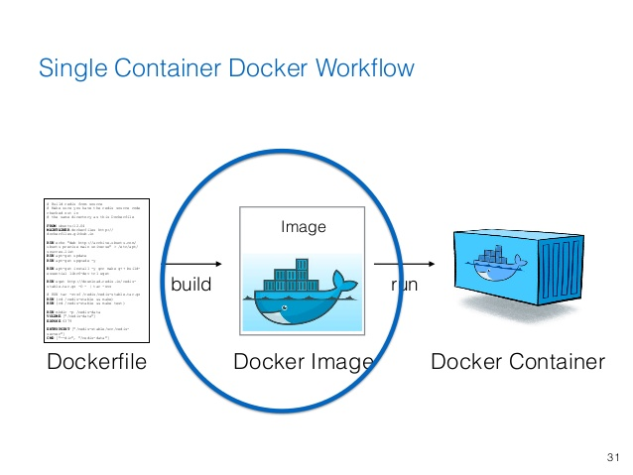
What makes Docker so great?
Before, if I wanted to send someone else my code. They would need to download all of the dependencies onto their system in order to get it to run.
Now, I can simply send over a Docker image, that is already preprocessed with all of the dependencies, and the other developer can run my Docker container with all fully functioning code.
This is great for cross-platform collaboration and time-to-value.

Slide 12
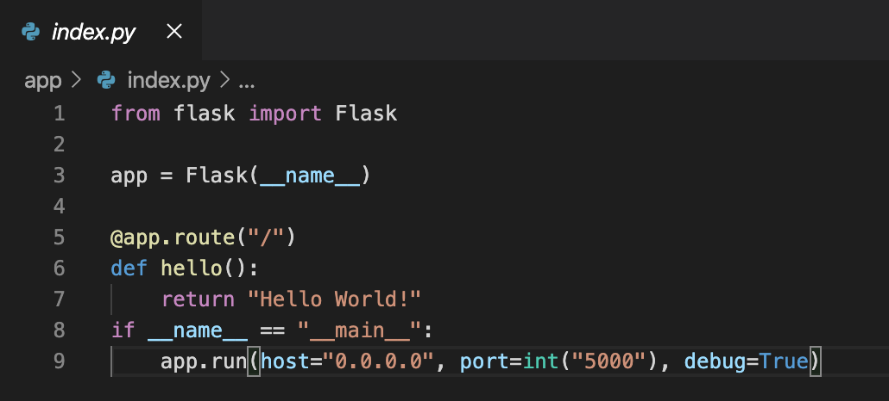
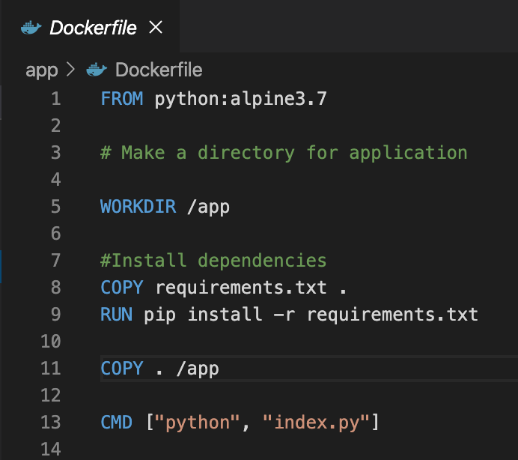
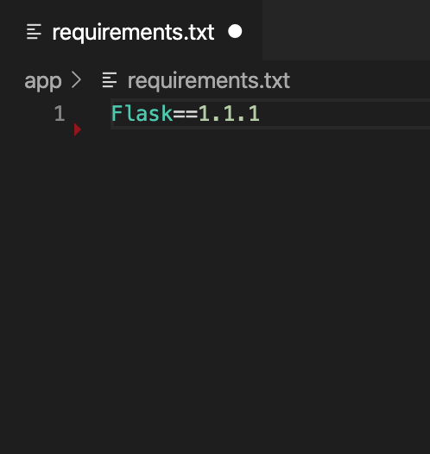
Code Examples
In this code example, I am creating a Flask app that produces a simple ”Hello World” message.
In my DockerFile, I am pulling the latest Python image, creating a working directory which will house my application, installing the library dependencies from the Flask import, copying the index.py file into the image, then running the Python script.

Slide 13
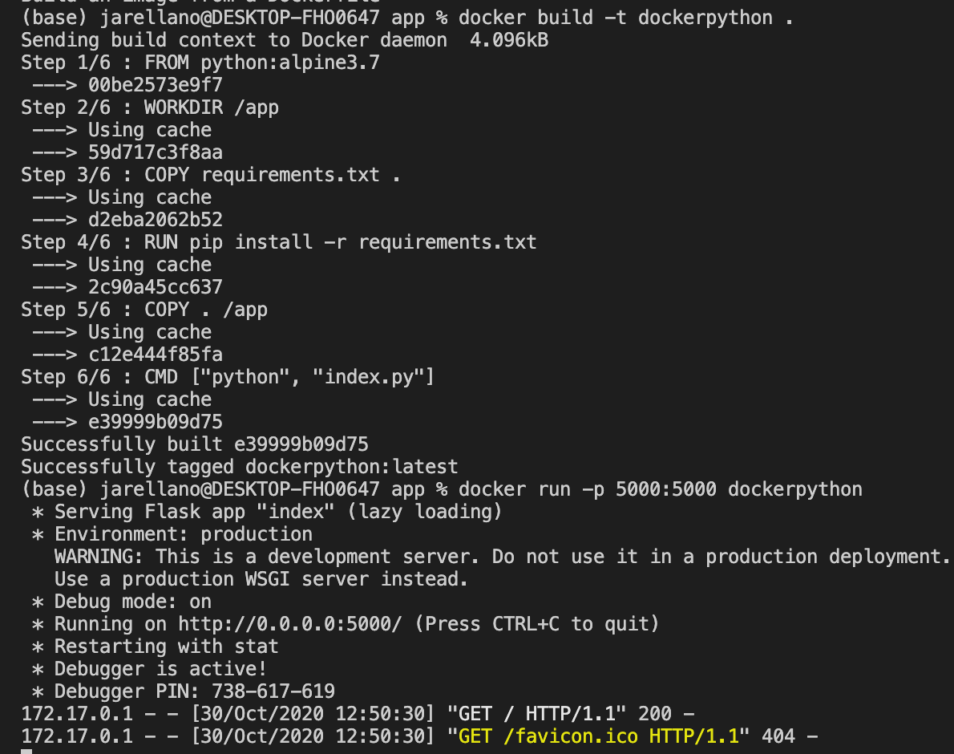
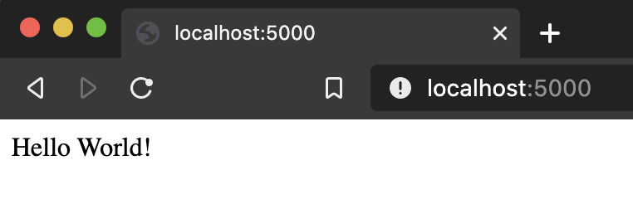
Code Examples
In order to run my Dockerfile, I call ‘docker build –t dockerpython .’ which will build my Docker image and give it the tag Python.
You can see all of the steps of my Docker file are being followed line by line when the script runs. This makes it easier to debug Dockerfiles if needed as you can see which step the build failed in.
I can then run my Docker container in port 5000 and if I go to localhost:5000, there is my Hello World statement!

Slide 14
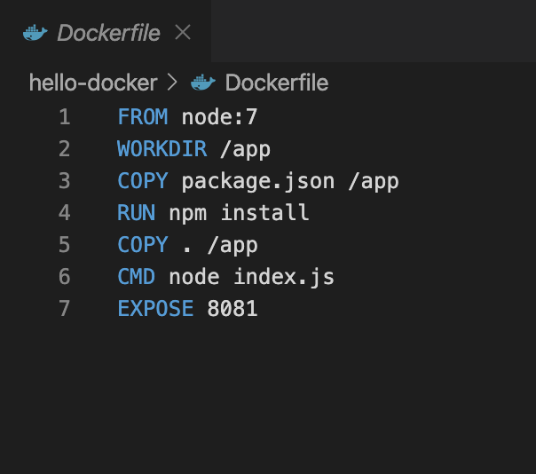
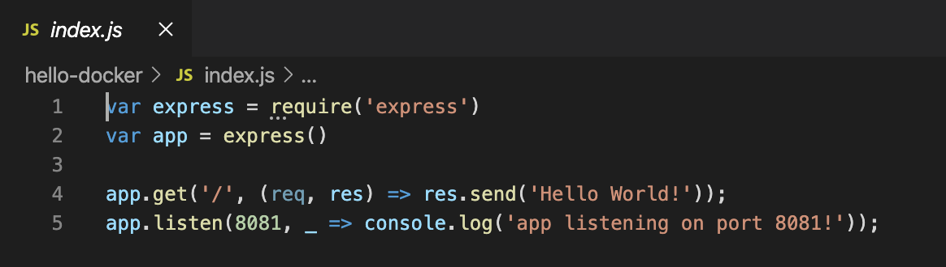
Code Examples
Another quick example is this Dockerfile I built for another “Hello World” type app, but in React.
This is just to show that Docker can be used for any development framework, and helps us to really manage all of our different tech stacks across systems and users.

Slide 15
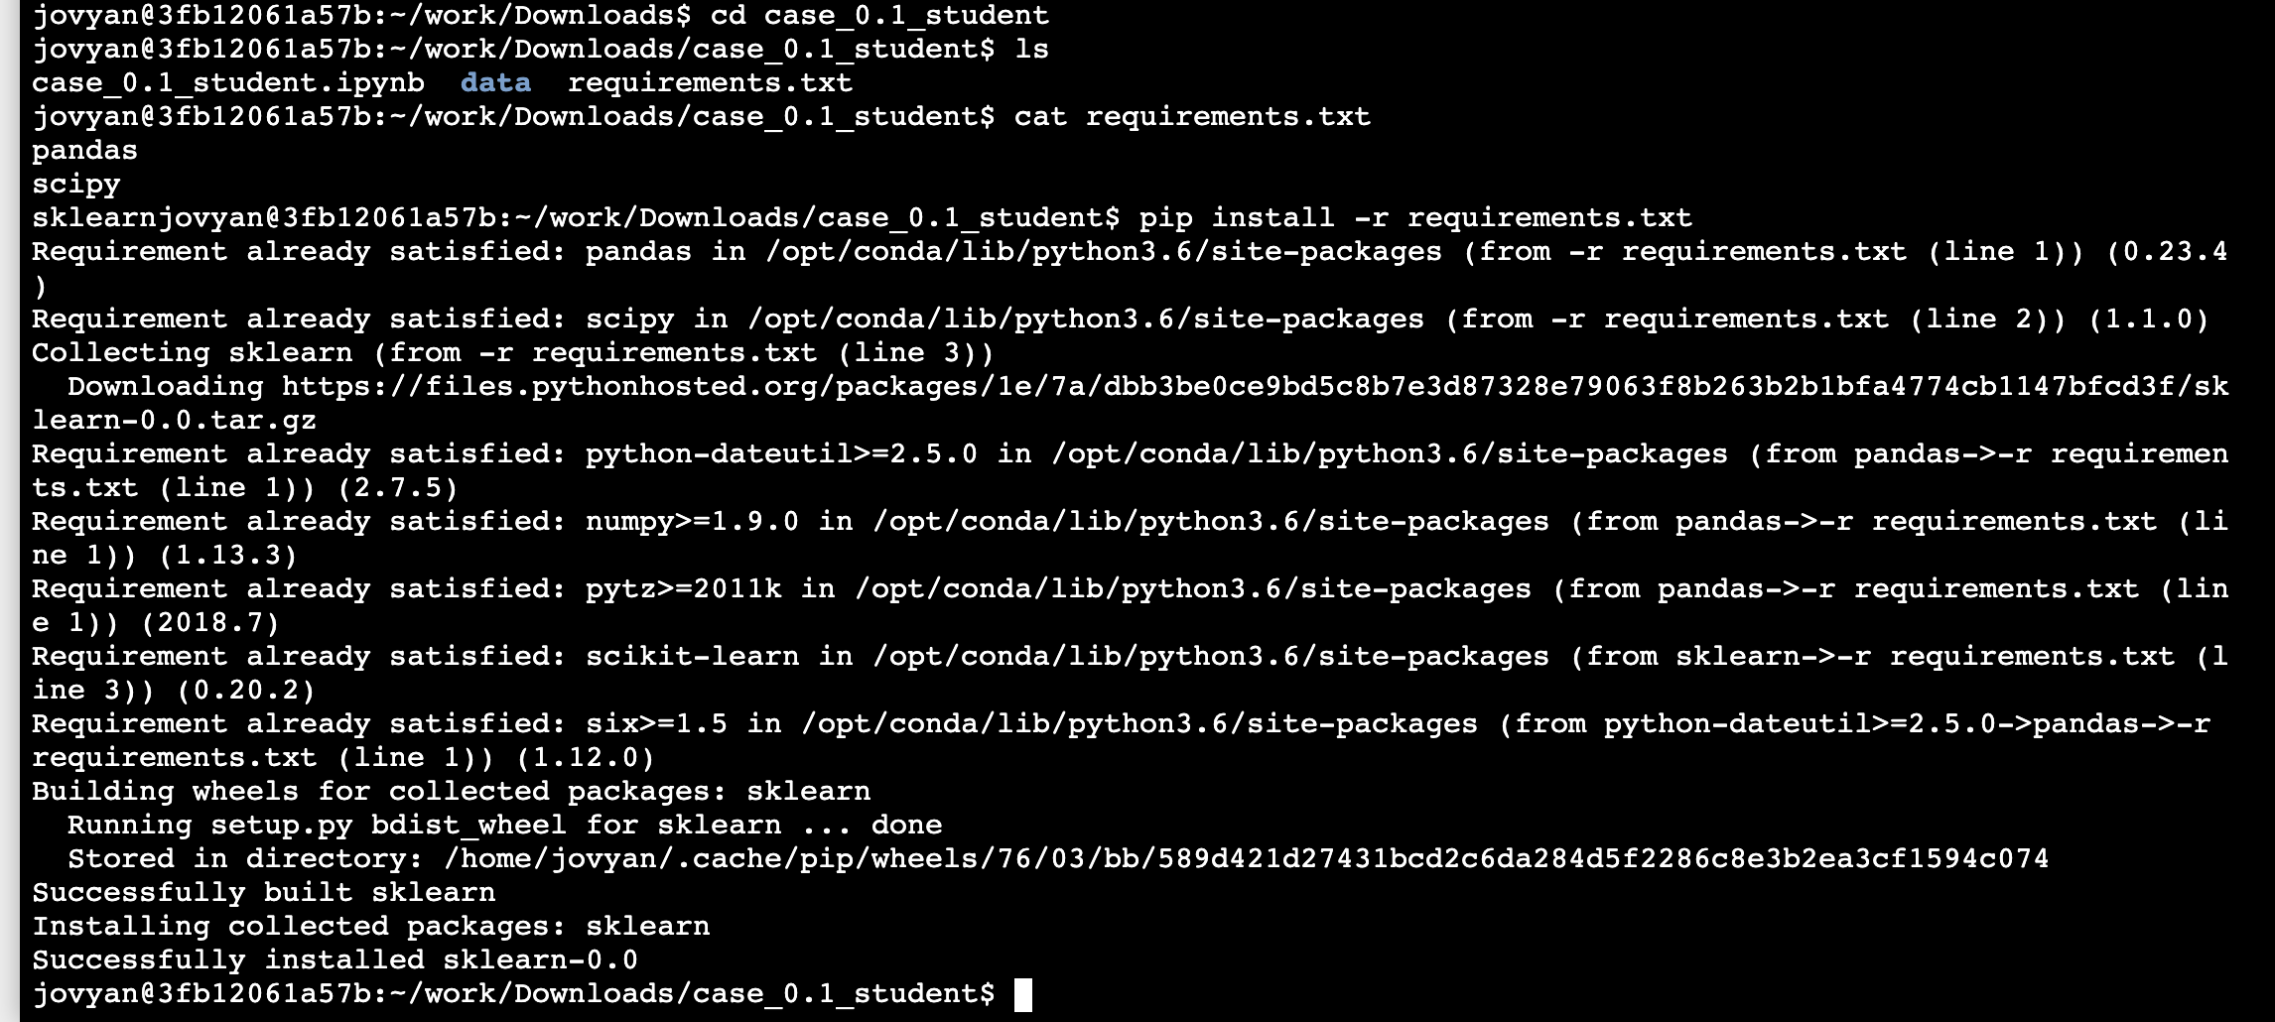
Code Examples

Slide 16
Resources
Free Docker Essentials course: https://www.udemy.com/share/101y0WA0UfcF1VR3w=/
Jupyter Notebook Using Docker for Data Science: https://www.youtube.com/watch?v=1PVJNPT0sXY
Docker and Python: making them play nicely and securely for Data Science and ML - Tania Allard –Talk https://www.youtube.com/watch?v=Jq68axbKIbg
Learn Docker & Containers using Interactive Browser-Based Scenarios - https://www.katacoda.com/courses/docker

Slide 17
Thank you!
Questions?

